Slide 2

Giving your Apps the Fluent UI Look and Feel with Delphi
Presented by Ian Barker about.me/IanBarker www.codedotshow.com/blog

Slide 3
Why this webinar? Why Fluent UI?
It is the latest iteration of Microsoft’s “design language” adopted by the latest versions of Windows 10 and Microsoft apps
If you are writing Windows applications then it’s a look and feel you need to be familiar with in order to ‘fit in’
A huge amount of Microsoft design effort resulting in a fresh aesthetic backed by overwhelming user experience research

Slide 4
Why this webinar? Why Fluent UI?
If you don’t evolve your designs then you might be perceived as ‘old fashioned’ or may implement UI features that clash with the Fluent UI in ways which hobble your application and/or frustrate your users
It’s not fair but they are bigger and dominate so they get to dictate the direction

Slide 5
What is “Fluent UI”?
It had an official code name Project Neon so you know it’s cool 😎
Official site is here: https://www.microsoft.com/design/fluent/
Also described less well here: https://en.wikipedia.org/wiki/Fluent_Design_System

Slide 6
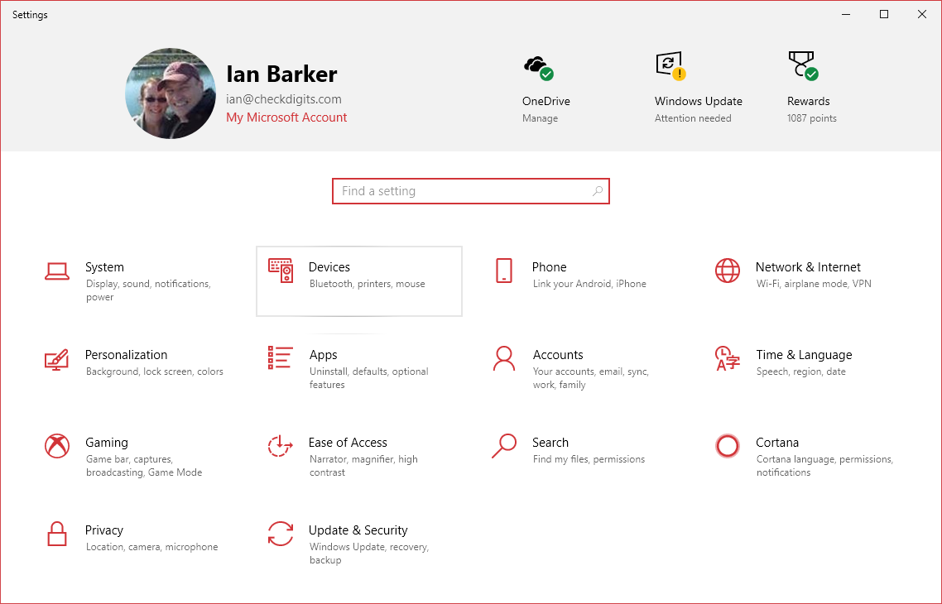
Fluent UI in action – Windows 10 settings screen

Slide 7
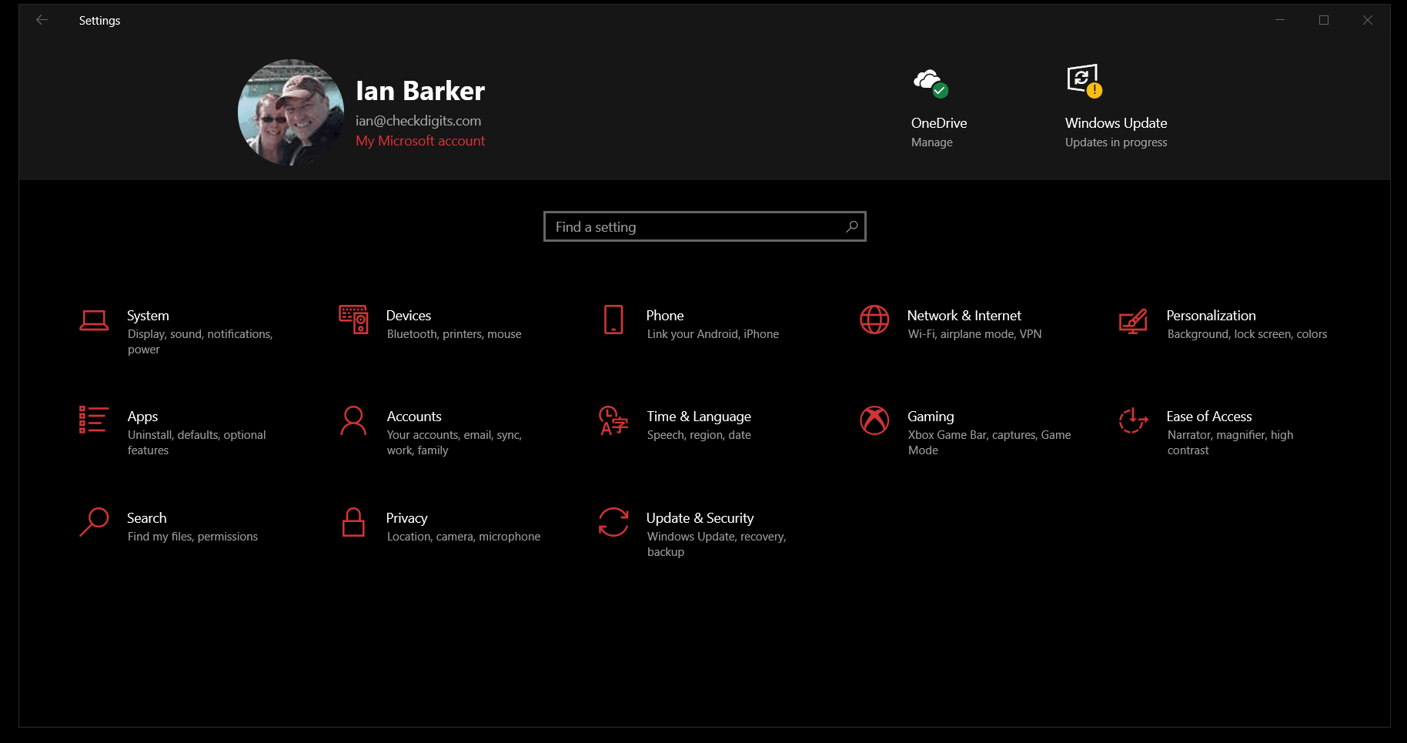
Fluent UI in action – also available, The Dark Side

Slide 8
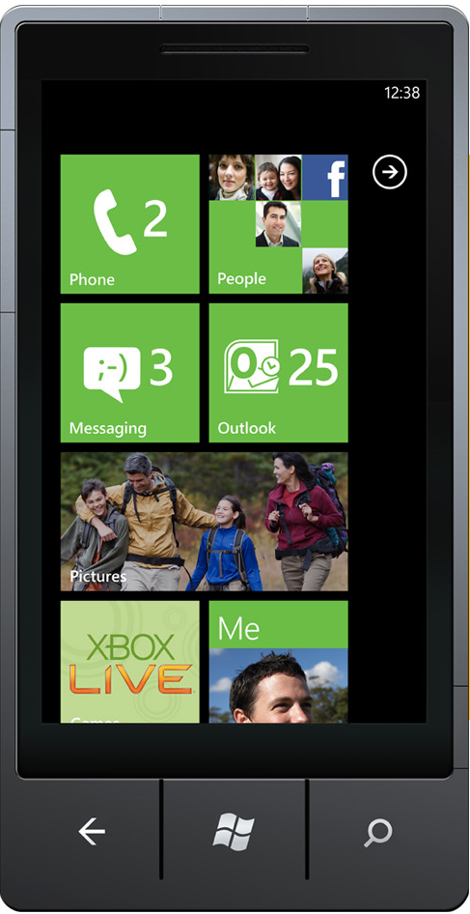
What was the thinking behind Fluent UI?
Revamp of the “Microsoft Design Language 2”
Which itself was an evolution of MDL1 a.k.a “Metro” – you remember Windows Phone?
https://en.wikipedia.org/wiki/Metro_(design_language)
Rejected!

Slide 9
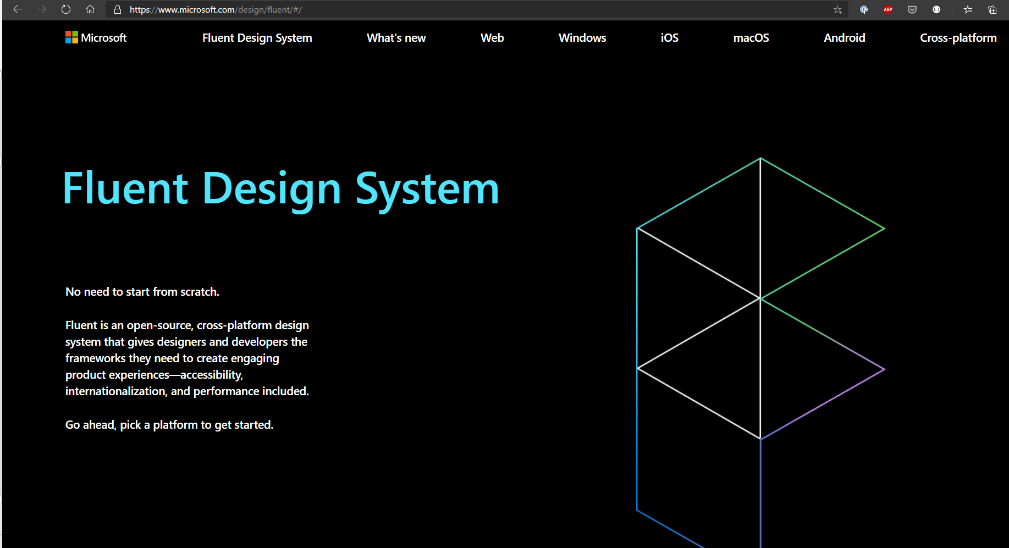
“Microsoft Fluent Design System”
“Microsoft Fluent Design System” described the new incarnation of the Microsoft Design Language
with an official debut in October 2017 as part of the Windows 10 Fall Creators Update.

Slide 10
Key Concepts
Light
Depth
Motion
Fonts and icons
Material
A lot of this had existed or was tried in previous incarnations of the MS design languages such as Metro and MDL1.
MDL2 → Fluent Design - solidified that into something more cohesive and tangible

Slide 11
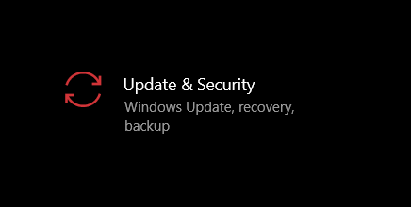
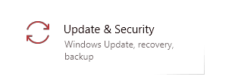
Key concepts… Light
Reveal highlight
Reveal focus

Slide 12
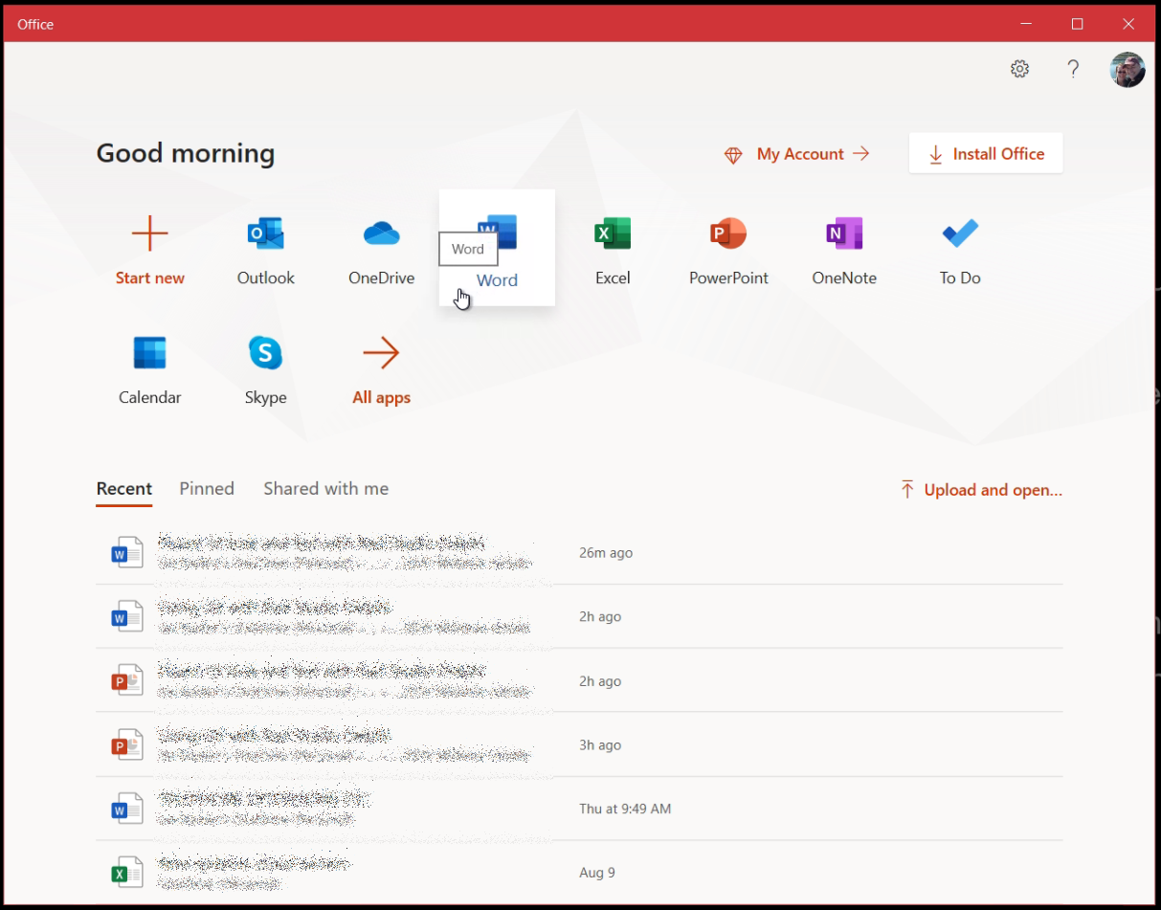
Key concepts… Depth
Along the Z axis for “content differentiation via layering”
Shadows are back!
Most noticeable in the Office 2019 App
Makes controls offer ‘affordance’ by becoming three dimensional or ‘phat flat’

Slide 13
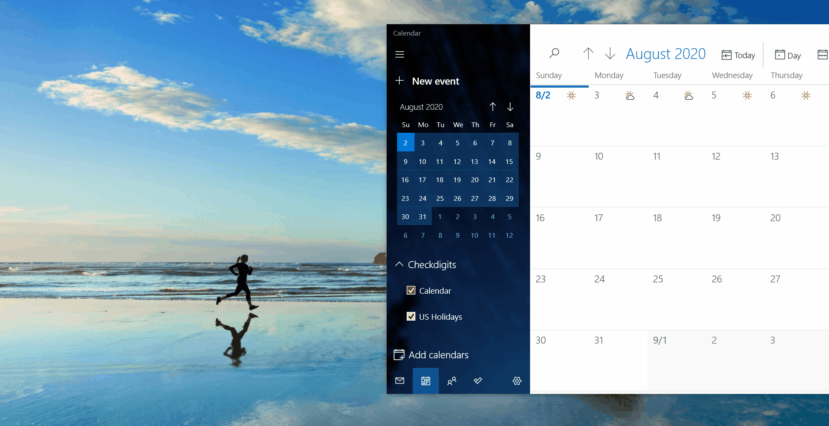
Key concepts… Motion
Windows 10 Mail App sign up screen shows this best!
Watch the clouds
Notes:
- Add/delete animations
- Connected animations
- Content transition
- Drill down
- Fade in/out
- Parallax - currently more visible on web pages but also applies to background images on windows with scrolling content
- Feedback on presses – “affordance”, did my click work?

Slide 14
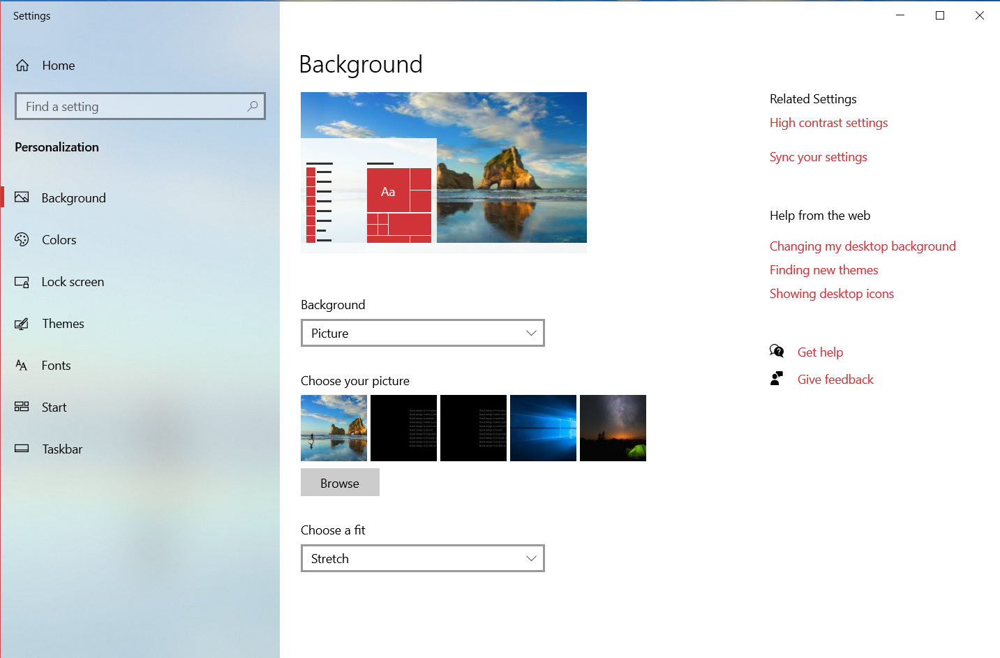
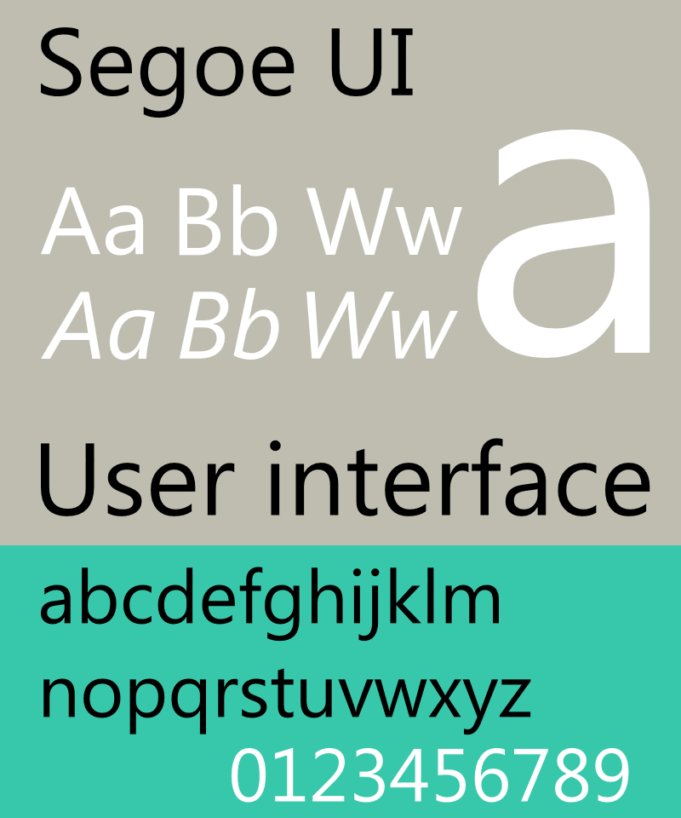
Key concepts… Fonts and icons
Segoe UI font everywhere
Notes:
SEE GO - Icons are the most noticeable part of the whole thing – and the Microsoft product managers are clearly still playing a tug of war with the UI and UX designers because they just redesigned virtually all the desktop icons for Microsoft’s apps 😊

Slide 15
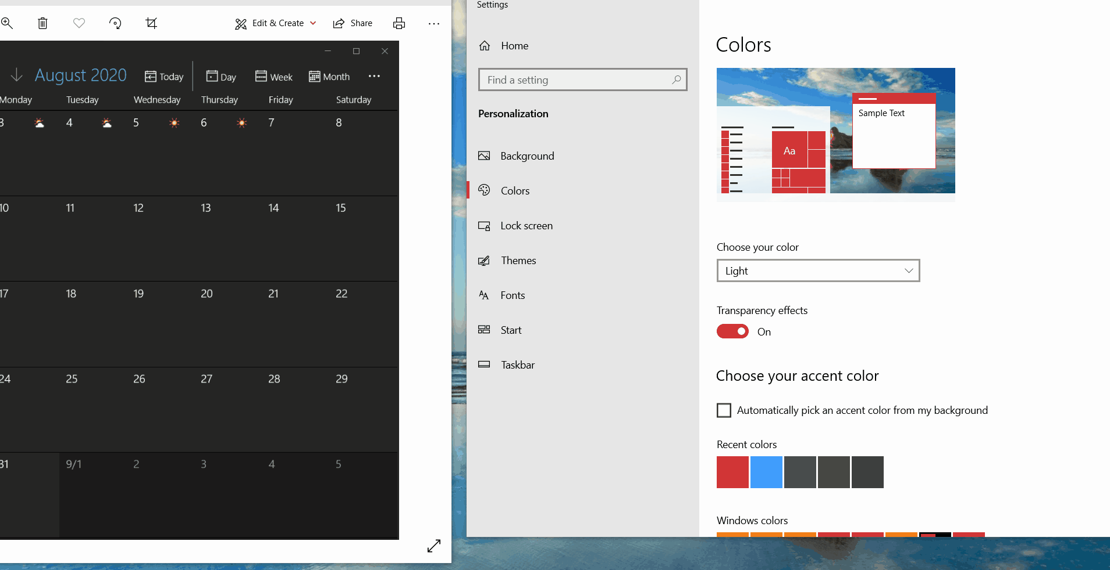
Key concepts… Material
‘Acrylic’
Dynamic blurring
Alpha layers and transparency

Slide 16
Let’s take a look!
Demo time

Slide 17
Good resources
Microsoft Official Fluent UI site
https://developer.microsoft.com/en-us/fluentui#/
Segoe UI
https://en.wikipedia.org/wiki/Segoe
Interesting blog post
https://medium.com/microsoft-design/how-fluent-ui-unlocks-the-next-generation-of-microsoft-365-experiences-8b24809faf06
Almedia Dev Style Controls
http://www.almdev.com

Slide 18
Good resources
My blog post about this webinar https://tinyurl.com/delphifluentui
You can reach me here https://about.me/IanBarker

